Slide 1
Introducing lcopt
An interactive tool for creating fully parameterised Life Cycle Assessment (LCA) foreground models
James Joyce
15/11/2017

Slide 2
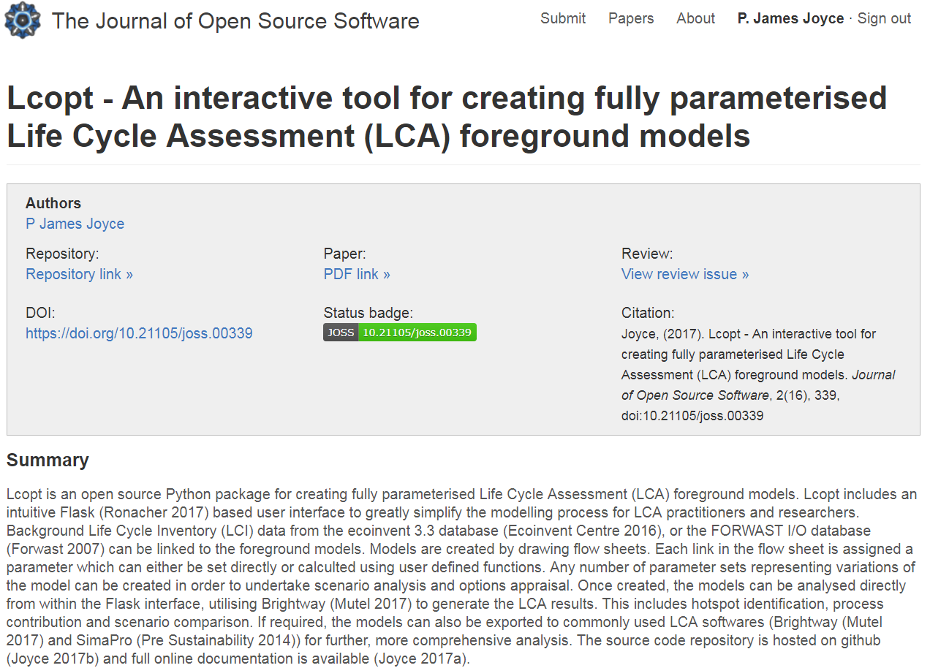
What is Lcopt?

Slide 3
Overview
LCA software
Lcopt modelling approach
Demonstration

Slide 4







LCA Software
Foreground modelling
LCI/LCIA calculation
Background modelling
Commercial
Freeware
Open source

Slide 5

LCA Software
Foreground modelling
LCI/LCIA calculation
Background modelling
Commercial
Freeware
Open source

Slide 6
Lcopt modelling approach

Slide 7
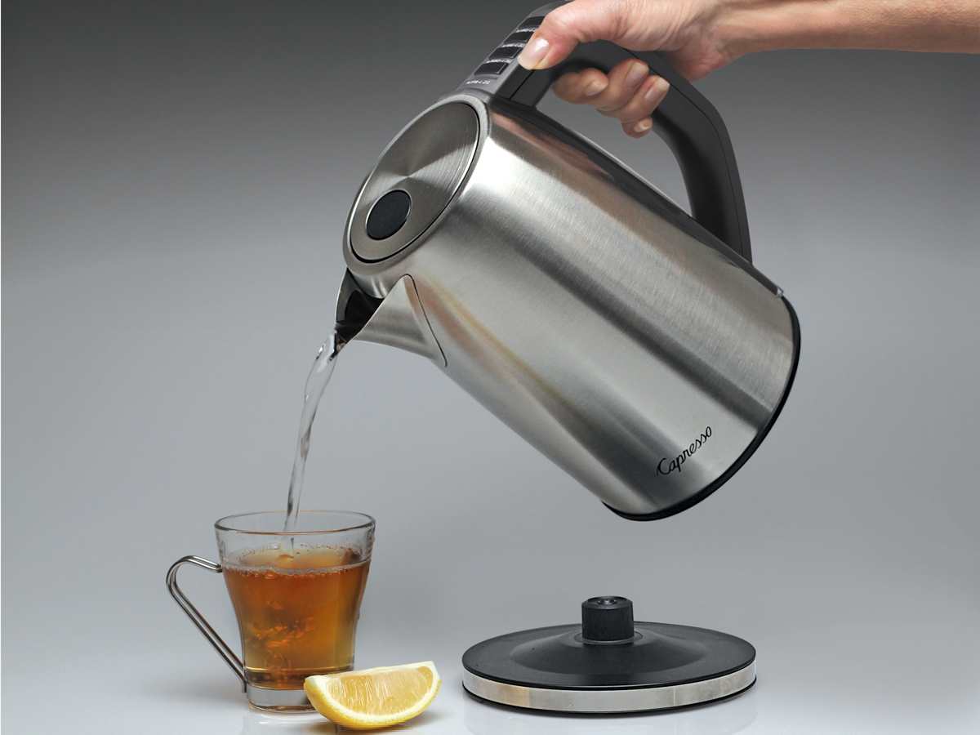
Making a cup of tea

Slide 8
Making a cup of tea
Electricity
Kettle
Water
Boiling Water
Teapot
Tea Leaves
Black tea
Tea cup
Milk

Slide 9
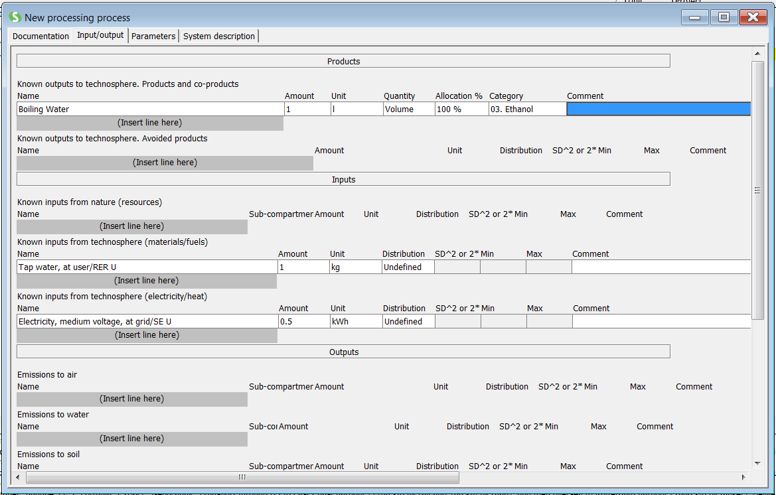
SimaPro

Slide 10
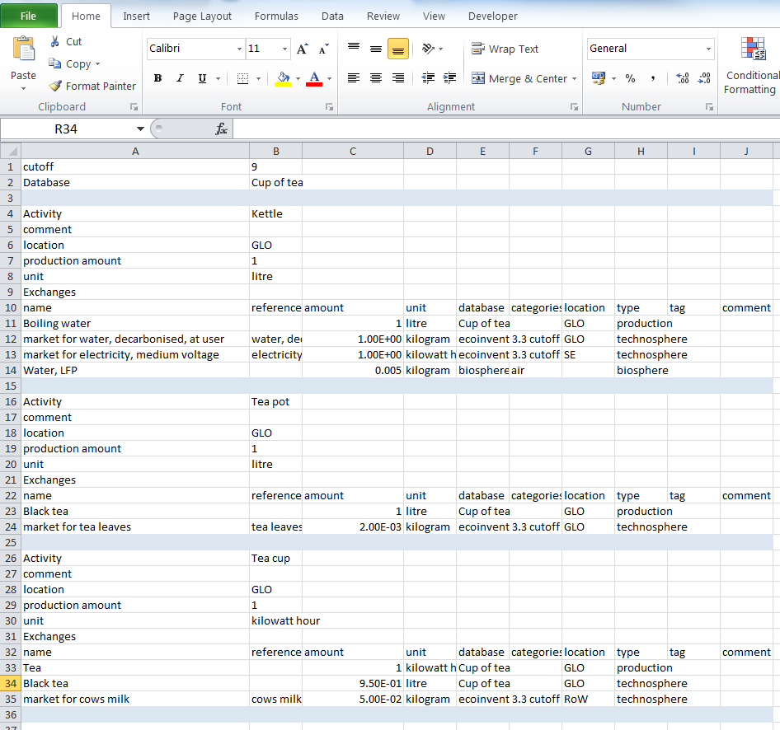
Excel and Brightway

Slide 11
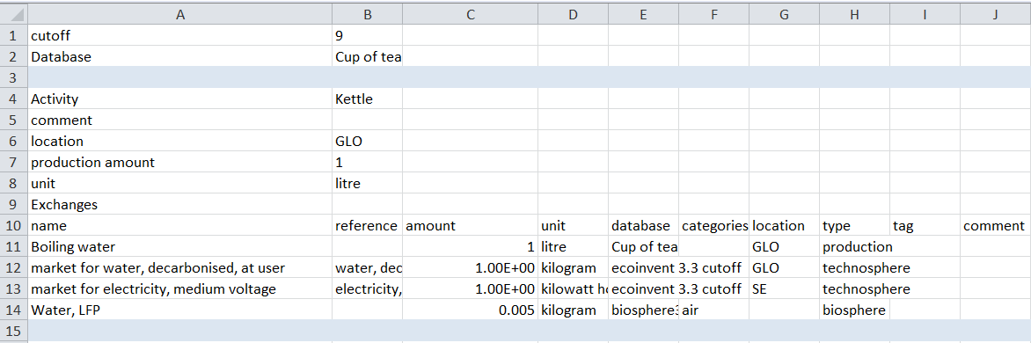
Excel and Brightway

Slide 12
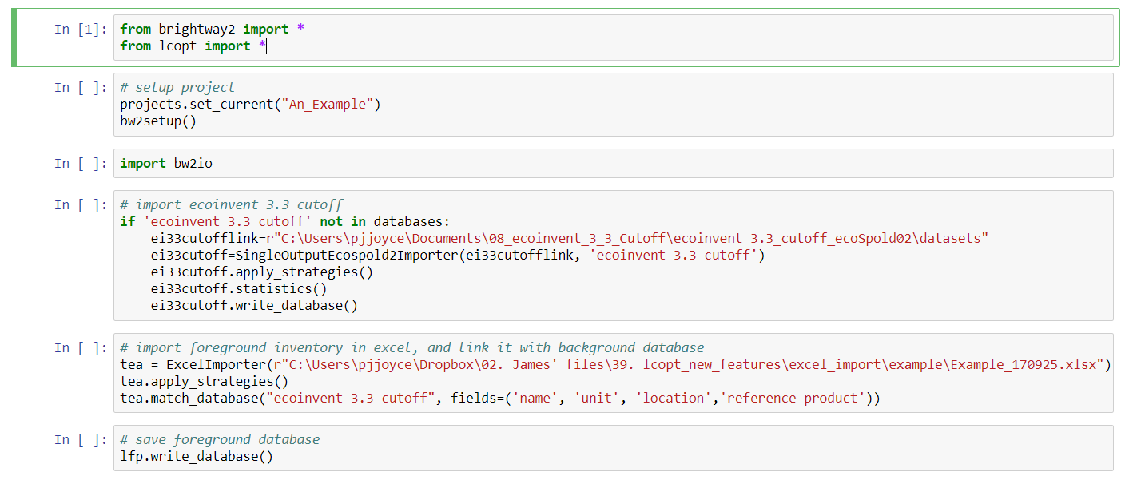
Excel and Brightway

Slide 13
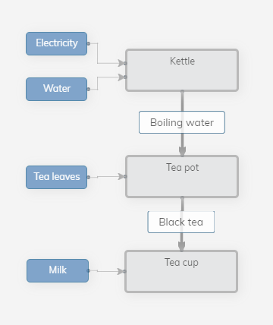
Lcopt
Notes:
To conduct a Life Cycle Assessment (LCA) we need to create a model of the life cycle of a given product or process which we can then use to estimate the potential environmental impact which results. This includes extraction of raw materials, processing, transport, use, disposal etc. etc.
Because each item used in a life cycle has it’s own set upstream processes the LCA model tends to be split into the foreground system - the processes under the control of the person doing the LCA - and the background system - the rest of the industrial economy which provides the materials and services required by the foreground system.
Background system models are either determined by data providers (e.g. ecoinvent) or can be customised using Ocelot.

Slide 14
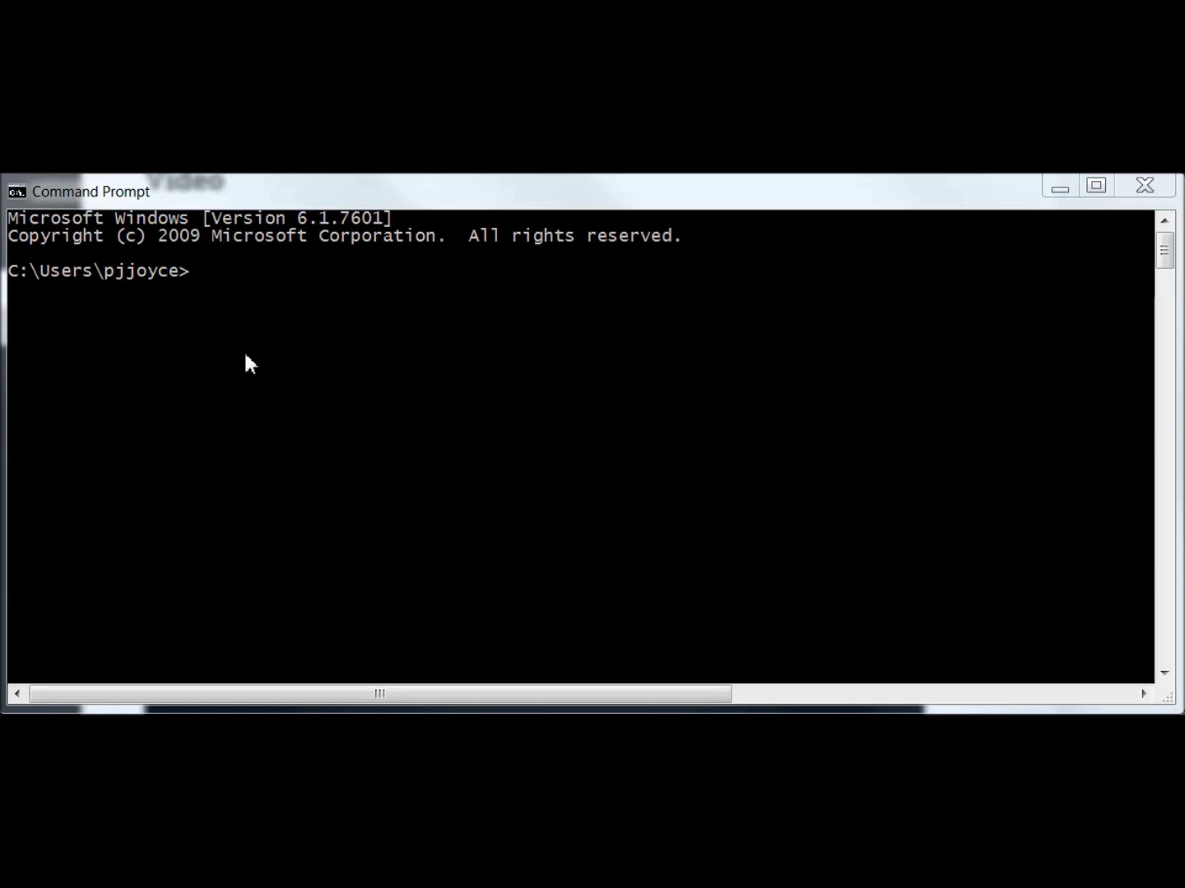
Demonstration
Notes:
The foreground model is a set of linked unit processes. A unit process describes a stage in the life cycle. It is basically a list of the exchanges required to produce one unit of an intermediate (or final) product. These exchanges can either be inputs from the technosphere - the human constructed industrial economy - or resources from or emissions to the biosphere. Technosphere exchanges can either come from the background system or other processes in the foreground system.
For example, when you make a cup of tea you make some boiling water, add this to some tea leaves, add some milk, then use/drink it.

Slide 15
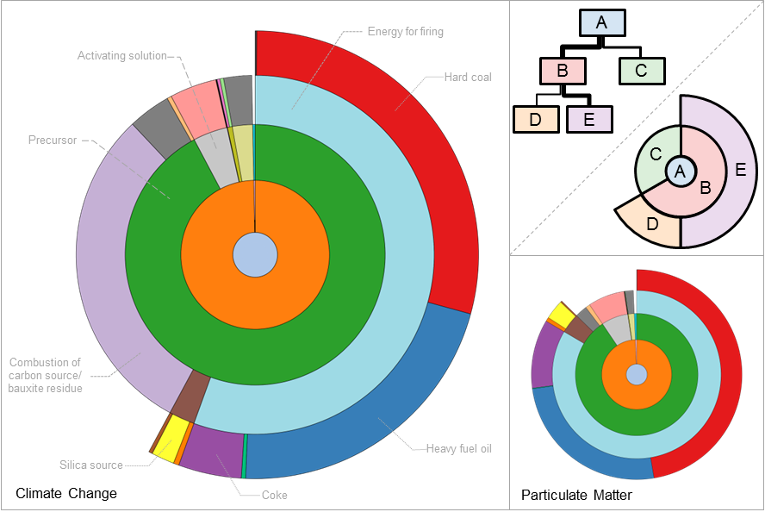
‘Real world’ example

Slide 16
Summary
Simple, intuitive way to create LCA models
Accessible for novice practitioners
New visualisations
Flexible and open source
Aim to build a community
Interact with the growing open source movement in LCA

